Slide 1
Intermediate Code Generation
Unit 4
Sini Anna Alex

Slide 2
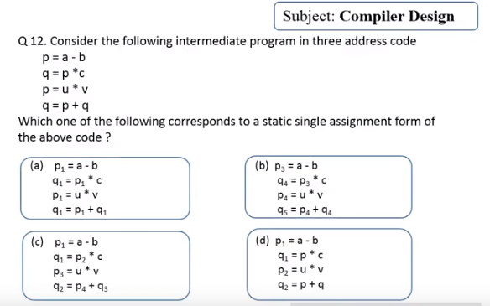
Ans: b

Slide 3
What is the triple representation of x[i]=y (Assume x is an integer array)
Three address Code:
t1=i*4
x[t1]=y
*x[t1] is computed as base address(x)+t1
Triple
op | arg1 | arg2
* | i | 4
[]= | (0) | y
0
1

Slide 4
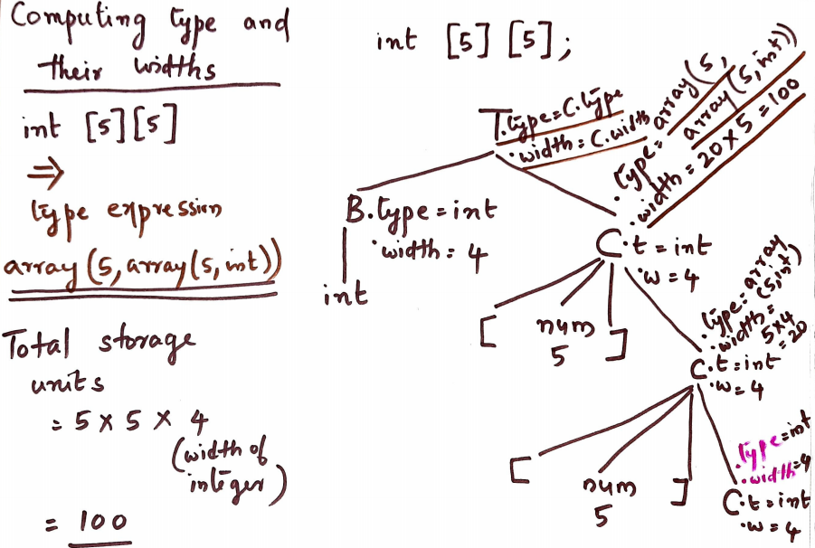

Slide 5
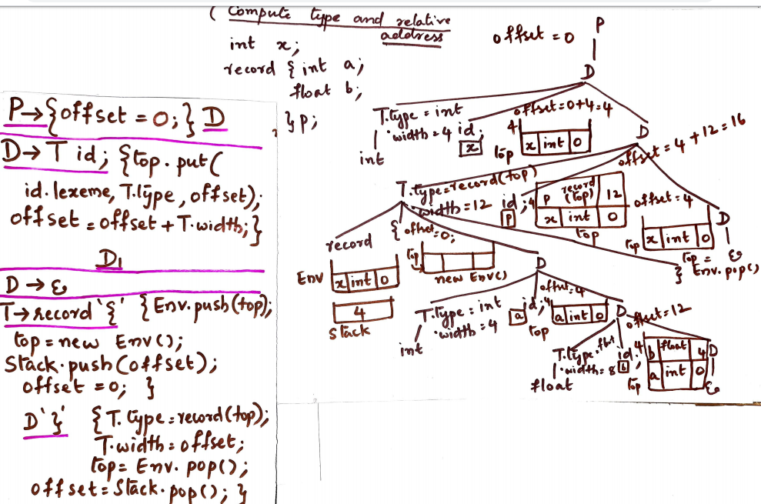
4

